Slide 1

Deep Water
Jo-fai (Joe) Chow
Data Scientist
joe@h2o.ai
@matlabulous
Data Science Milan
Politecnico di Milano
10th October, 2016

Slide 2
Agenda
First Talk (25 mins)
About H2O.ai
Demo
A Simple Classification Task
H2O’s Web Interface
Why H2O?
Our Community
Our Customers
What’s Next?
New H2O Features
Second Talk (25 mins)
H2O for IoT
Predictive Maintenance
Anomaly Detection
H2O’s R Interface
Third Talk (25 mins)
Deep Water
Demo
H2O + mxnet on GPU
H2O’s Python Interface

Slide 3
Deep Learning in H2O

Slide 4
H2O Overview
4

Slide 5

A Simple Neural Network
Image credit: http://cs231n.github.io/
5

Slide 6
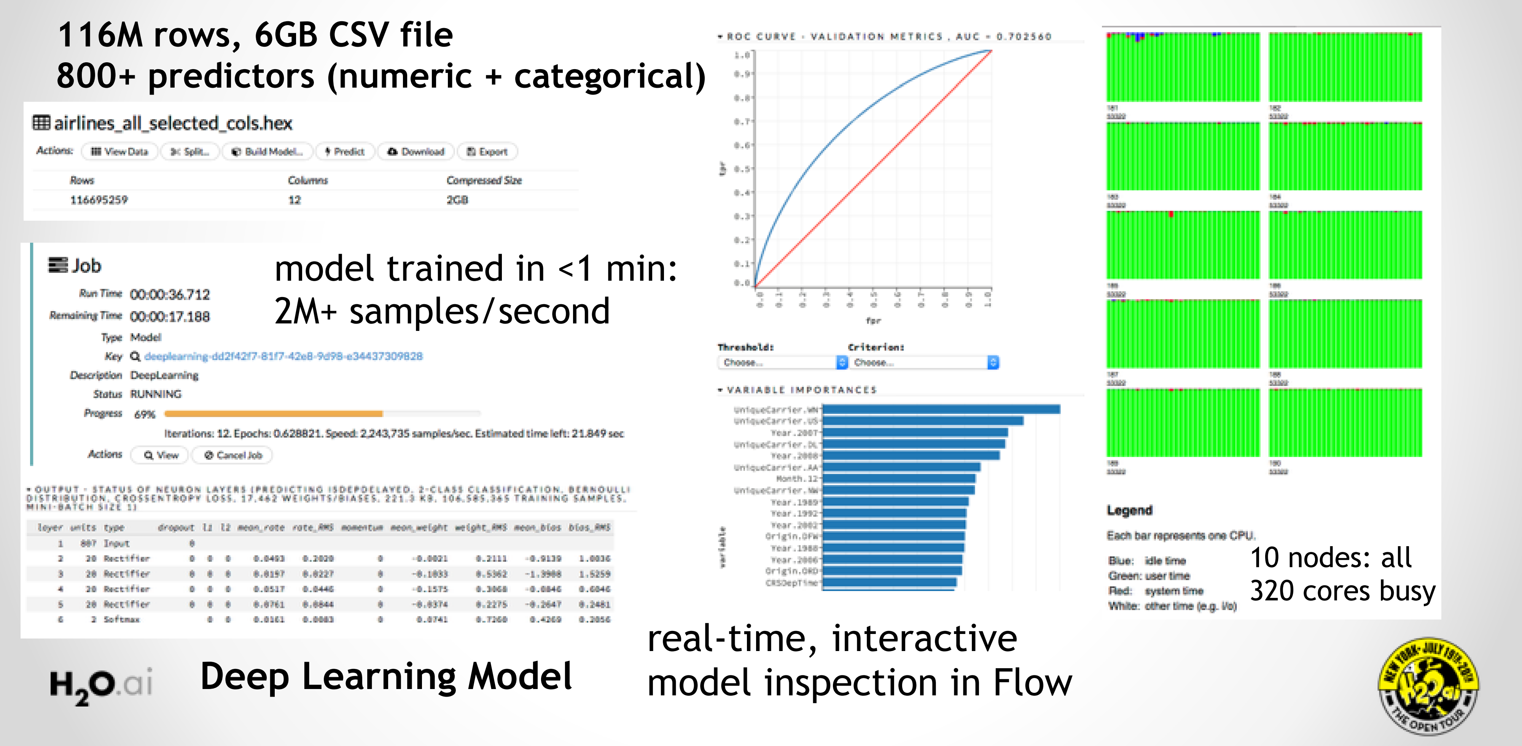
H2O Deep Learning in Action

Slide 7
H2O Deep Learning Community Quotes

Slide 8
Why Deep Water?

Slide 9
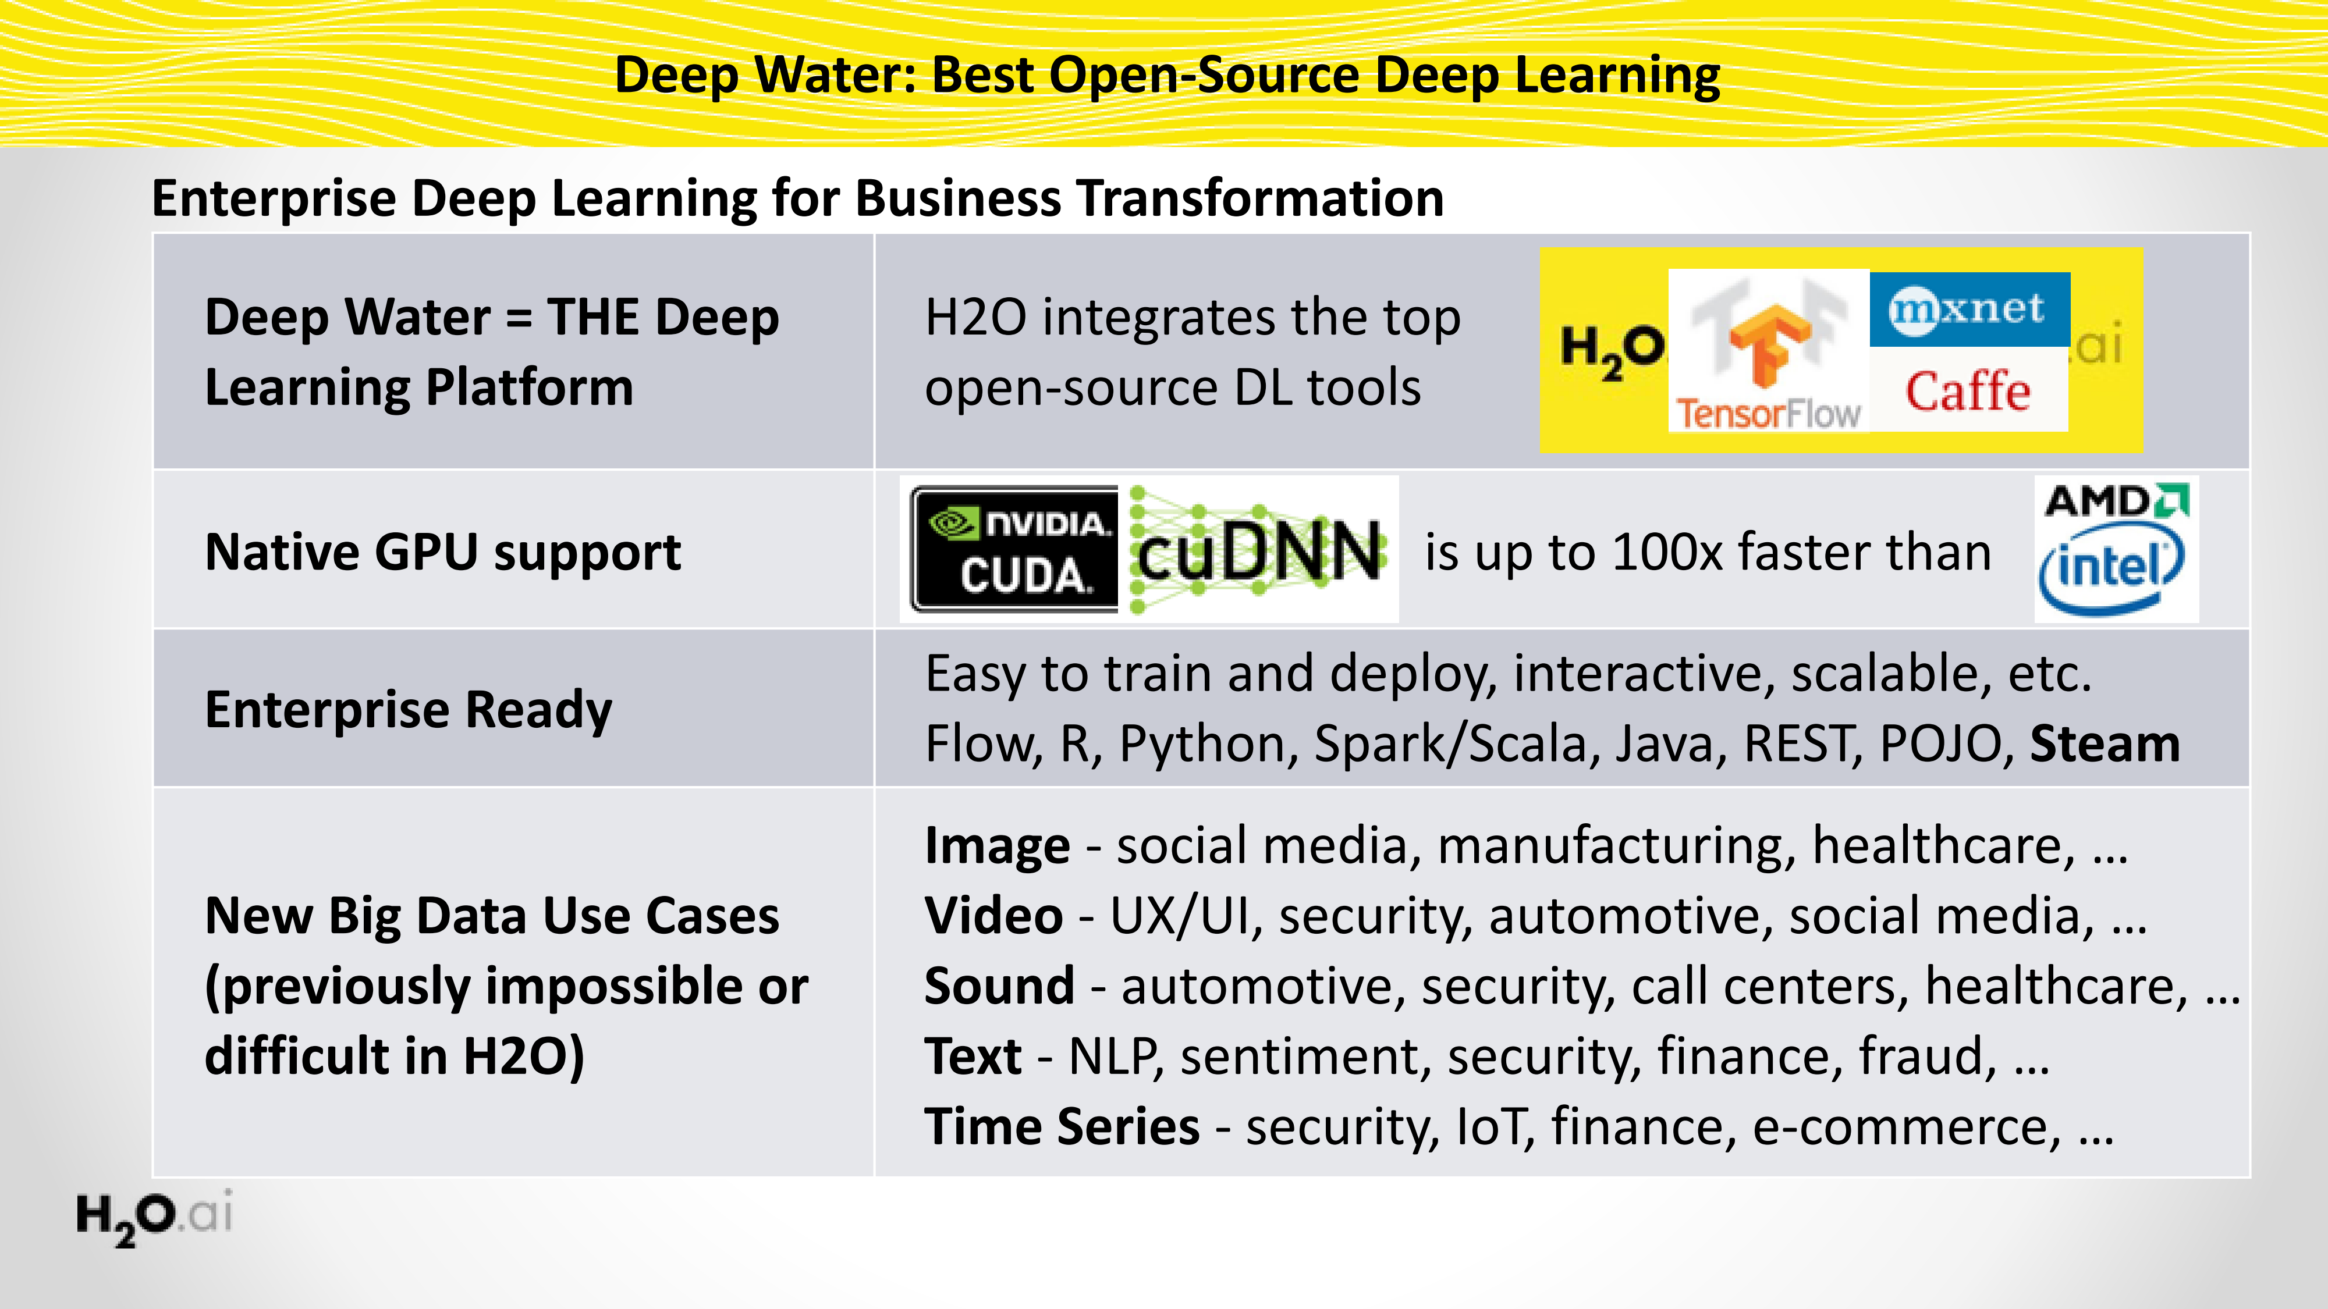
Deep Water: Next-Gen Deep Learning in H2O

Slide 10
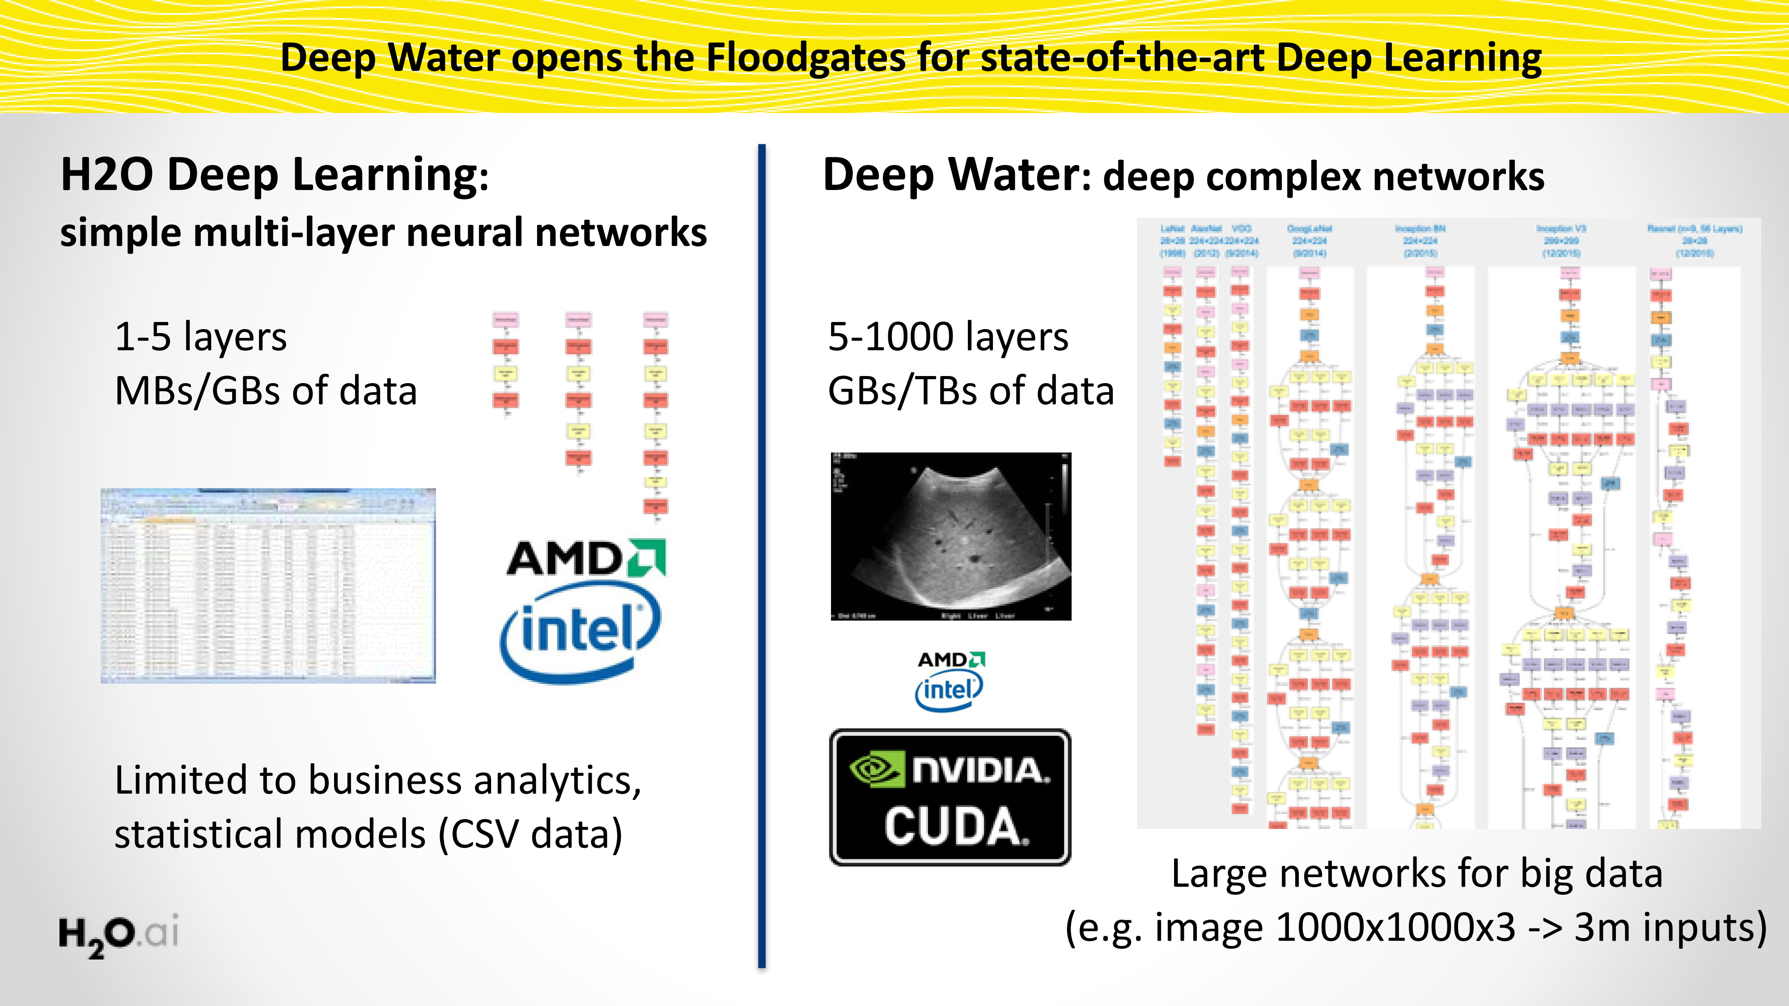
Deep Water opens the Floodgates for State-of-Art Deep Learning
10

Slide 11
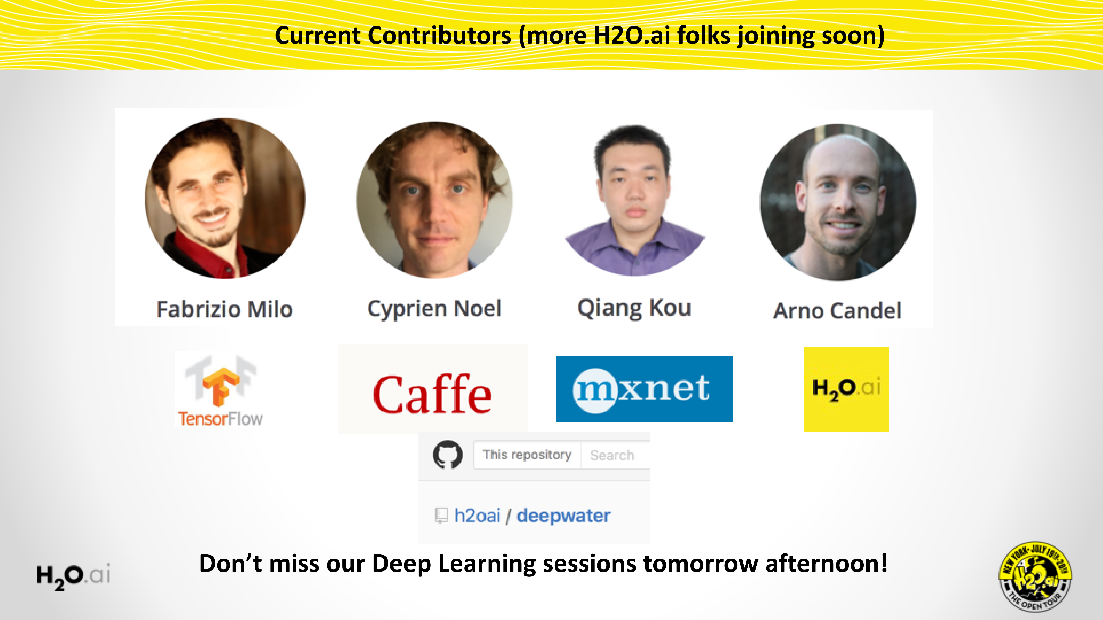
Deep Water opens the Floodgates for State-of-Art Deep Learning
11

Slide 12
Deep Water Demo

Slide 13
Deep Water Demo
H2O + mxnet
Dataset:
Cat / Dog / Mouse
H2O Python interface
mxnet GPU backend
Train a LeNet (CNN) model
Explore model in Flow
Code and Data
bit.ly/h2o_milan_1
subfolder
deep_water_demo

Slide 14
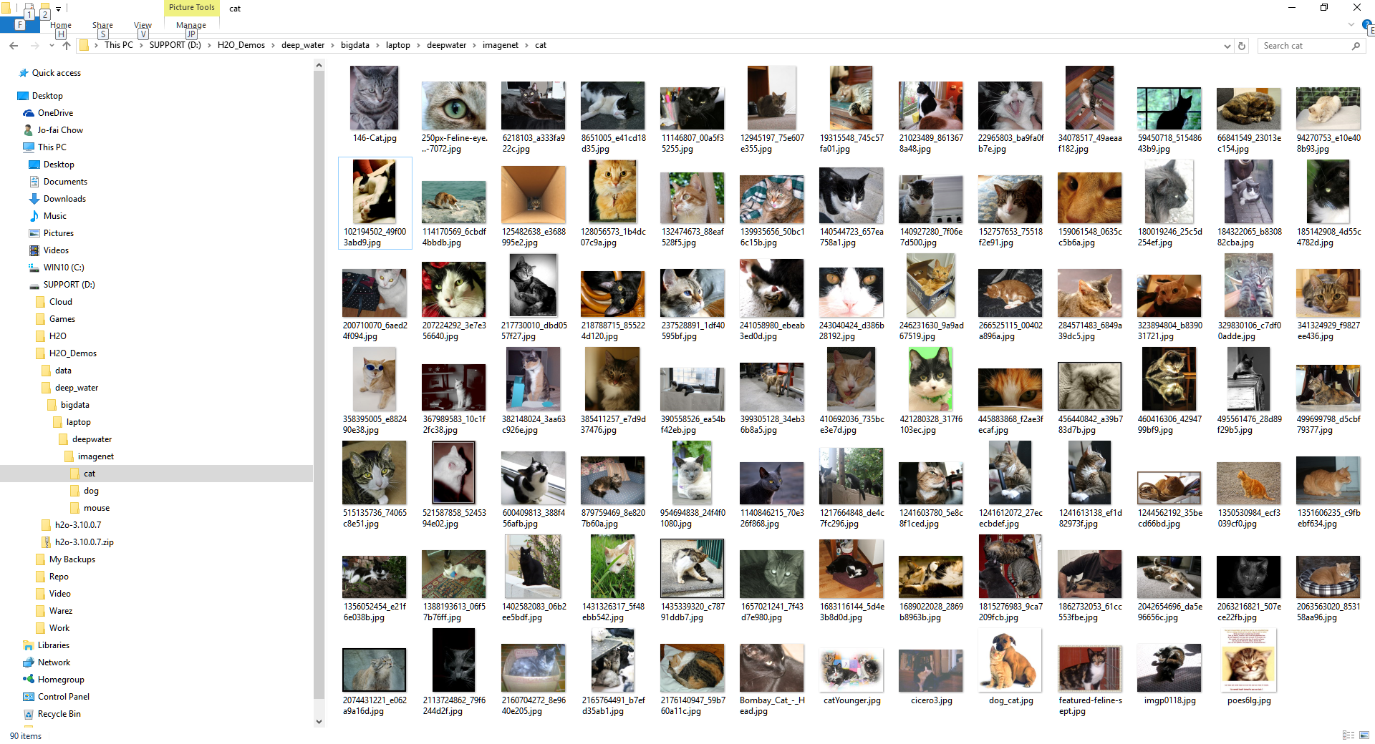
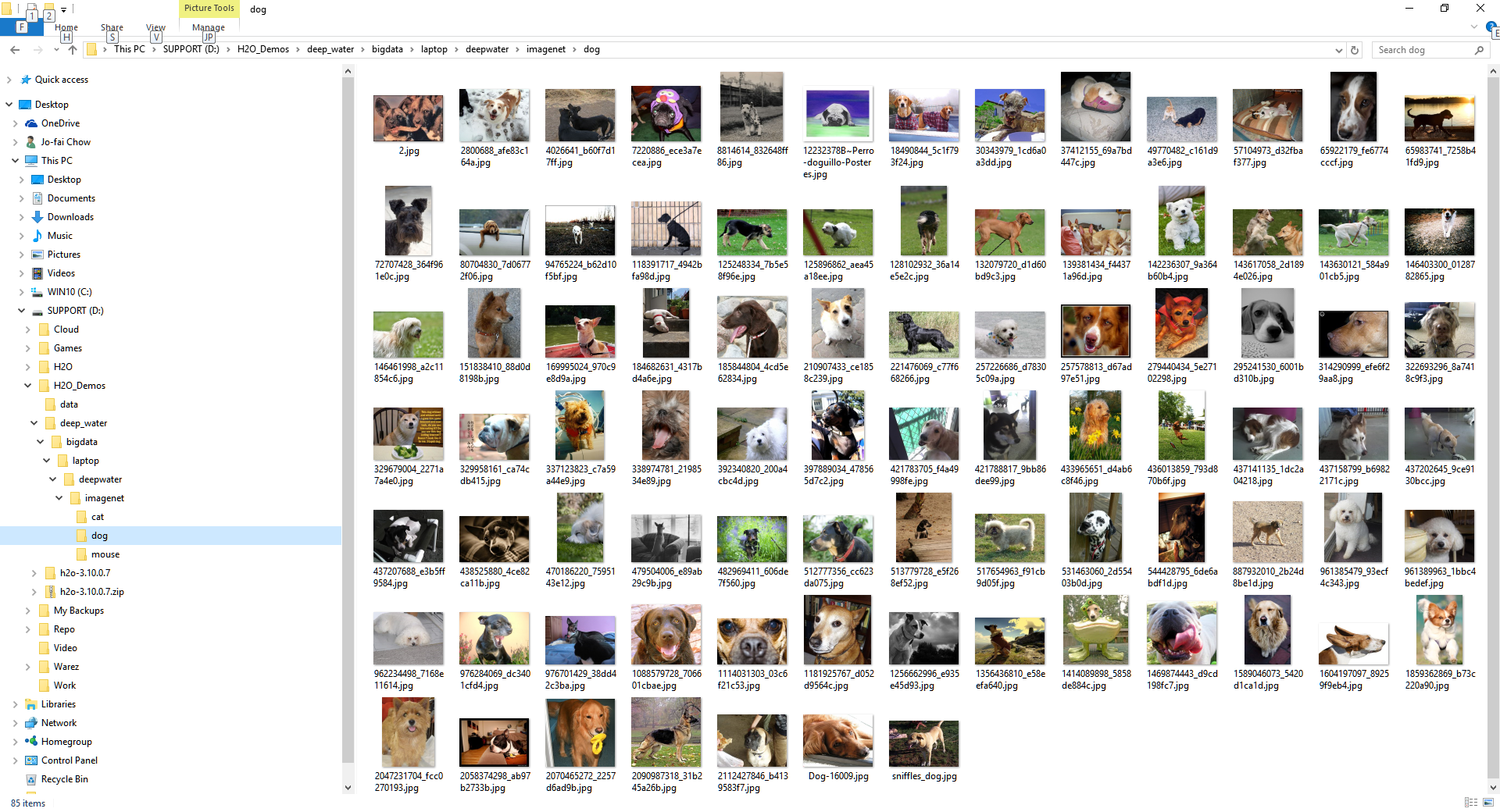
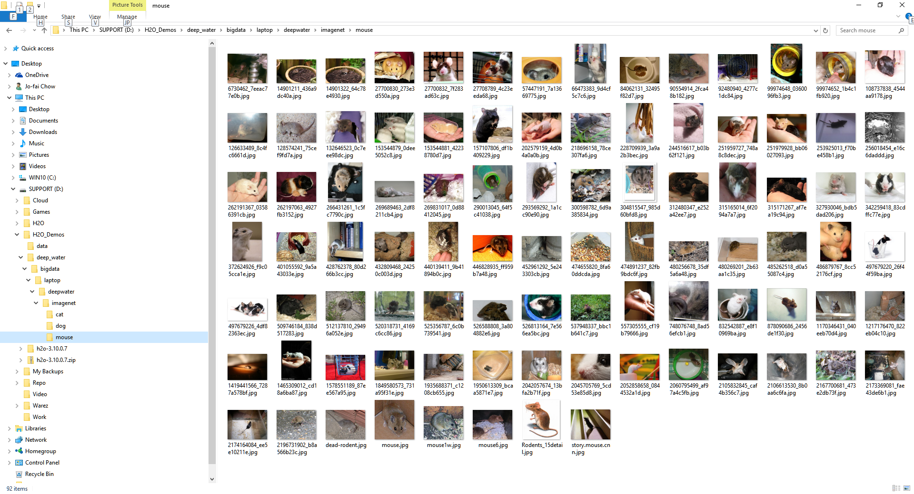
Data – Cat/Dog/Mouse Images

Slide 15
Data - CSV

Slide 16
H2O + mxnet Demo

Slide 17
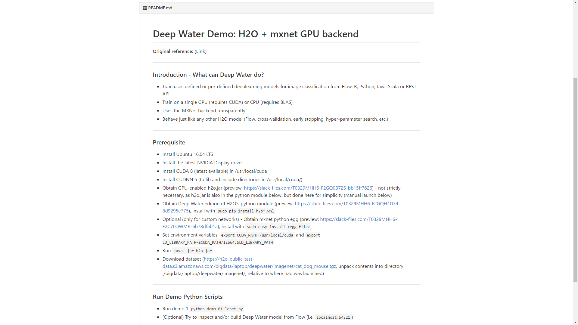
bit.ly/h2o_milan_1
Subfolder: deep_water_demo

Slide 18
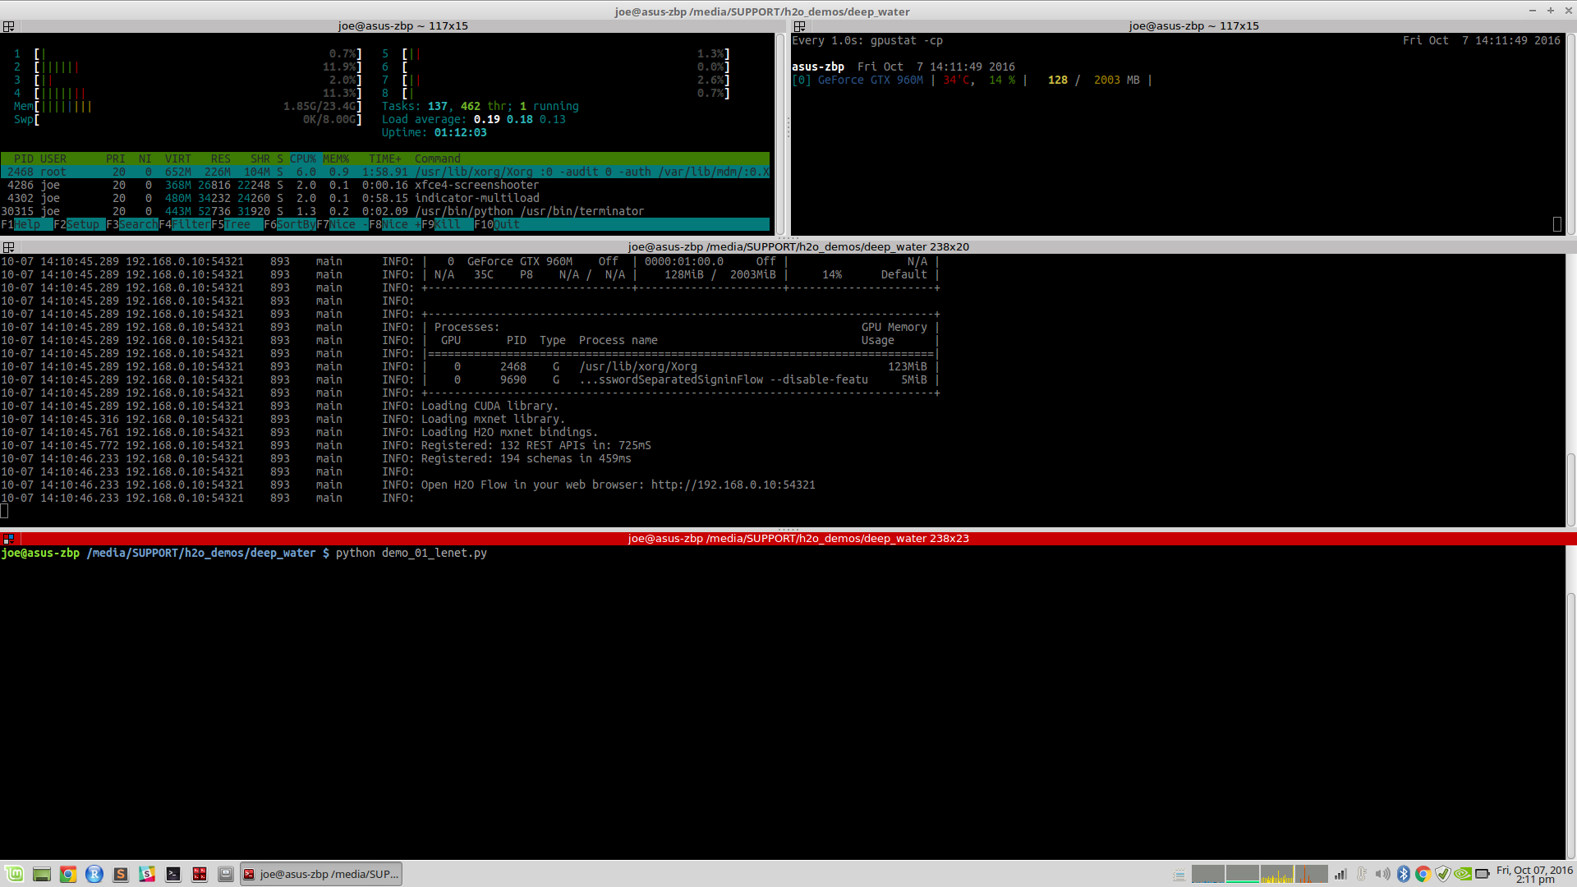
“htop”
(monitoring CPU/RAM)
“gpustat”
(monitoring GPU)
“java –jar h2o.jar”
H2O JVM Cluster
Deep Water Edition
“python demo_01_lenet.py”
Python script for demo

Slide 19
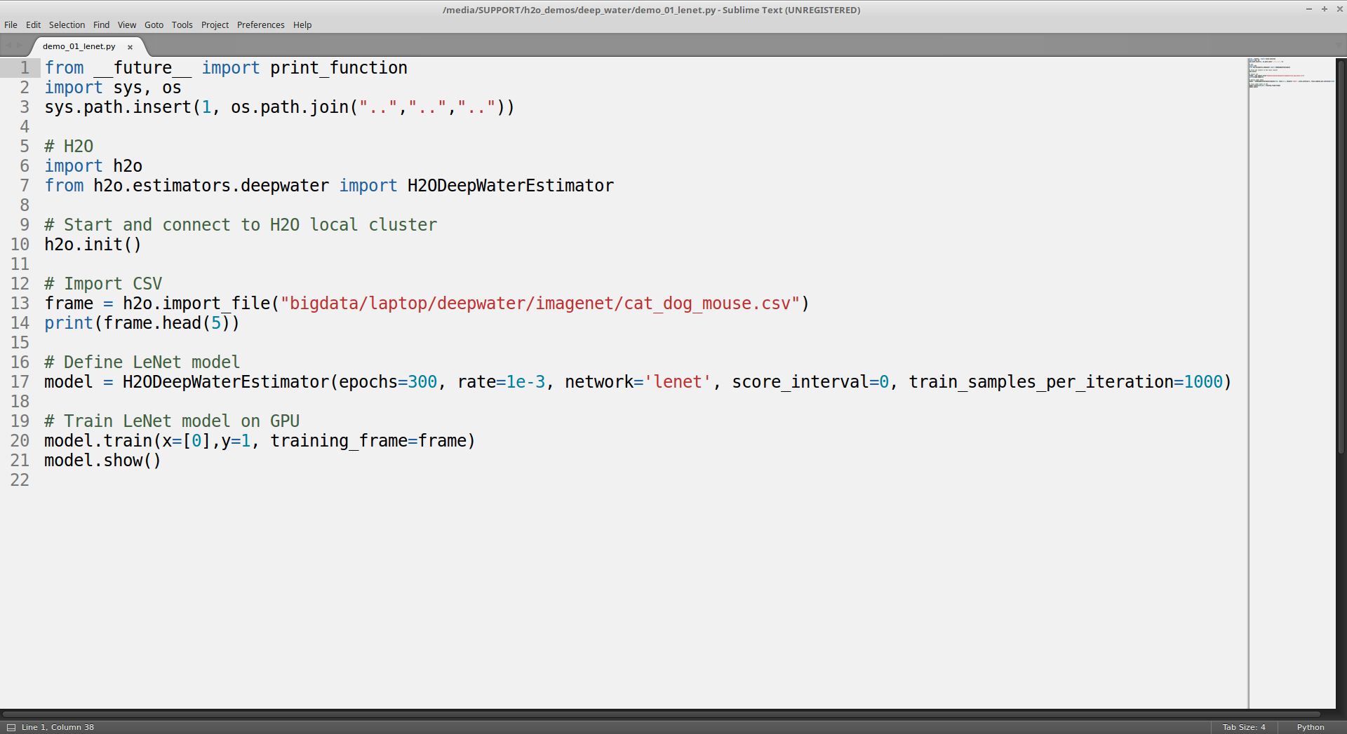
H2O’s Python Module
Deep Water module
Connect to H2O Cluster
Import CSV
Define LeNet model in Deep Water
Train and show model

Slide 20
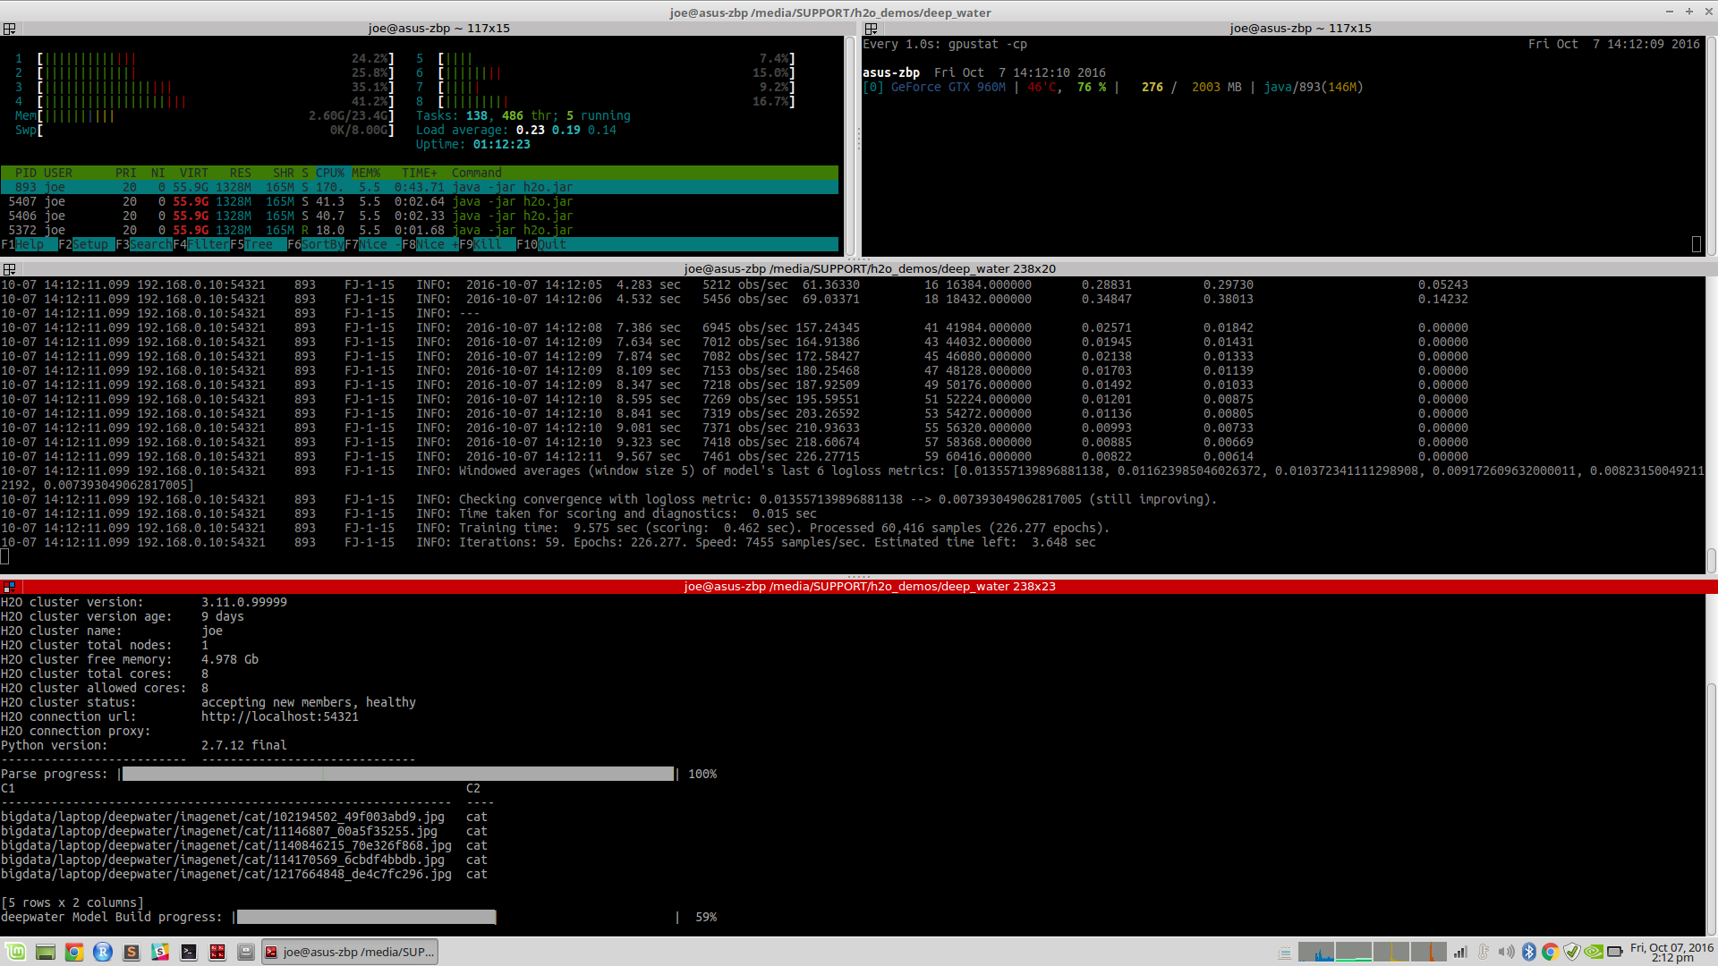
CPU for other tasks
Using GPU for LeNet model training
Note: H2O’s JVM on GPU
H2O JVM Cluster
“python demo_01_lenet.py”
Training LeNet Model

Slide 21
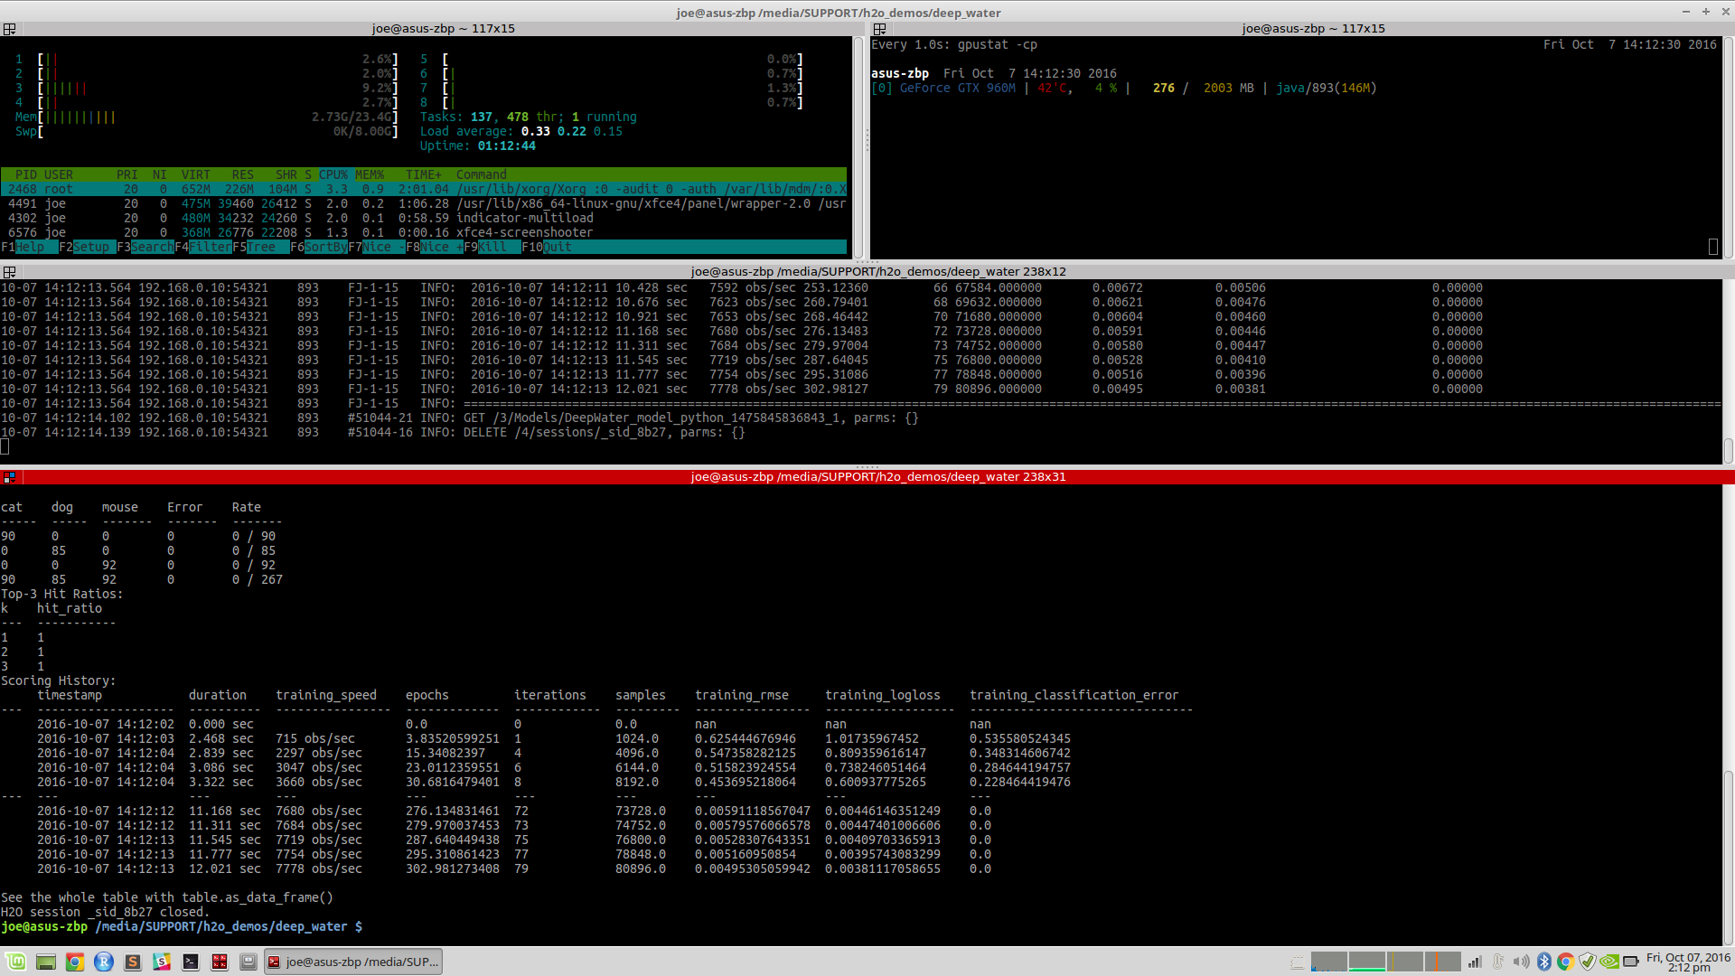
“python demo_01_lenet.py”
Showing LeNet Model

Slide 22
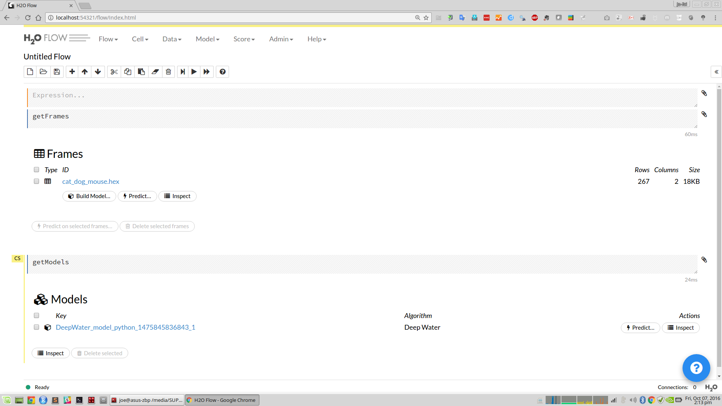
Using Flow (localhost:54321) to explore data frame and model

Slide 23
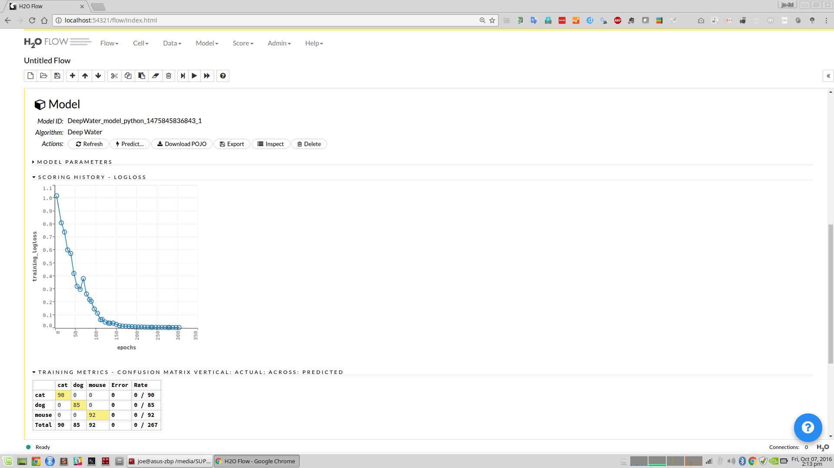
Using Flow (localhost:54321) to explore data frame and model

Slide 24
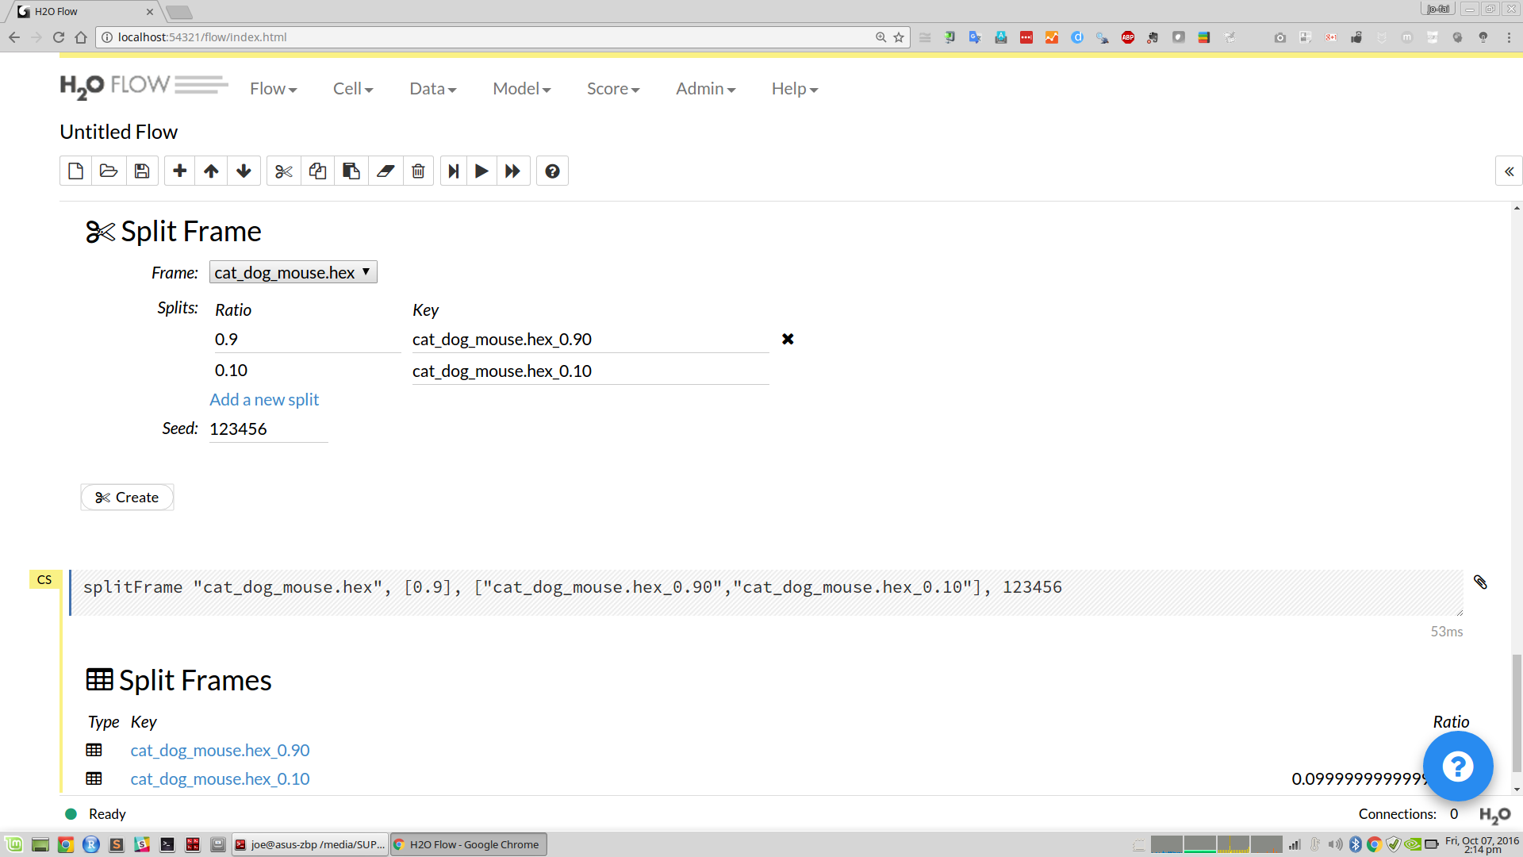
Using Flow (localhost:54321) to split data and train Deep Water model

Slide 25
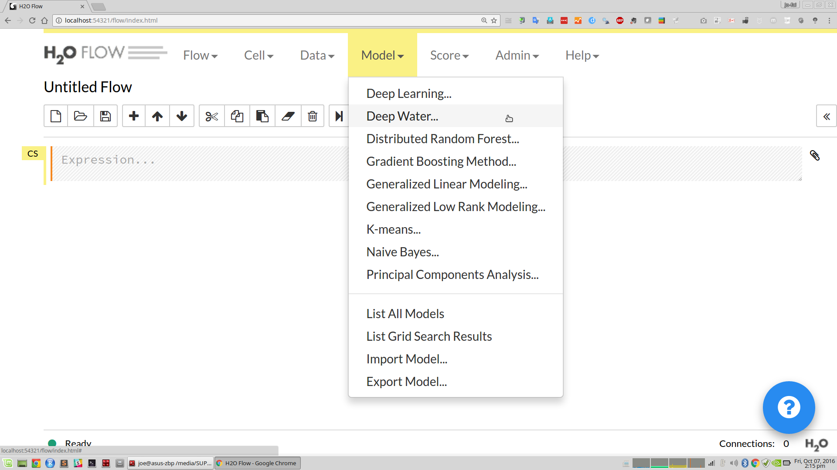
Using Flow to train Deep Water Model

Slide 26
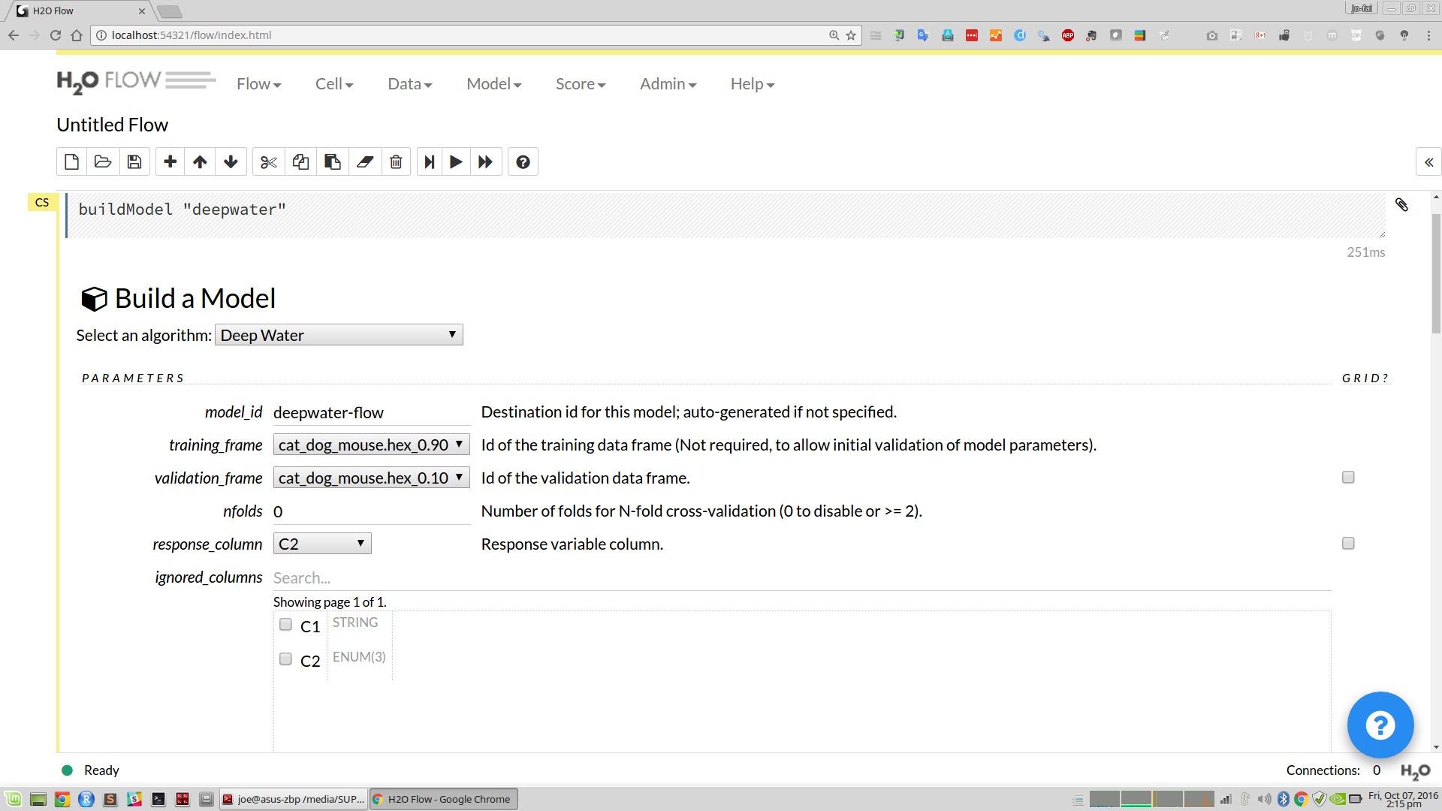
Using Flow to train Deep Water Model

Slide 27
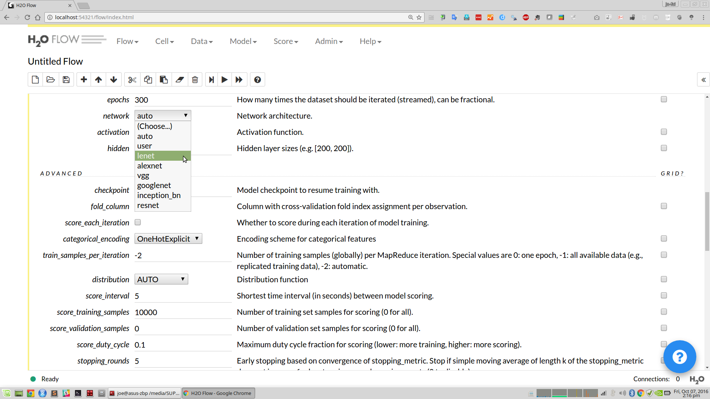
Choosing Different Network Structure

Slide 28
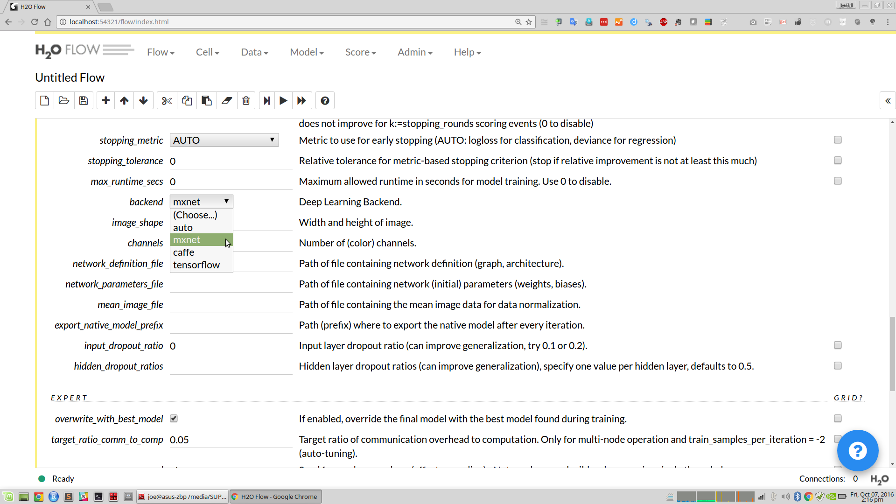
Choosing Different Backend

Slide 29
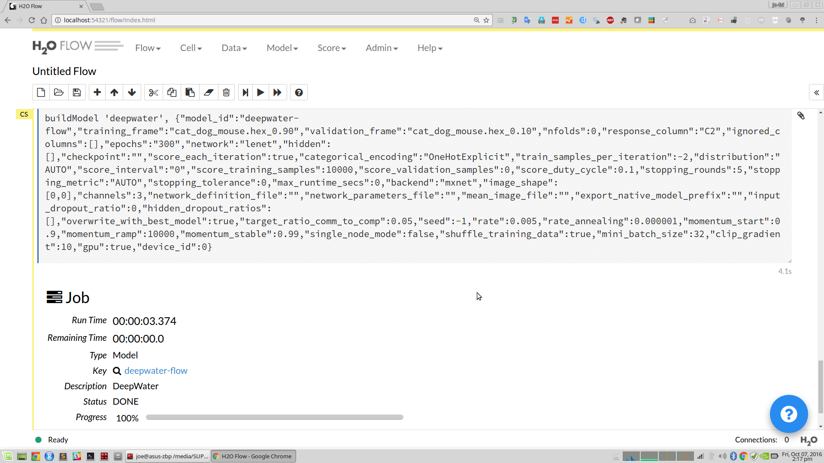
Training Deep Water Models without Programming

Slide 30
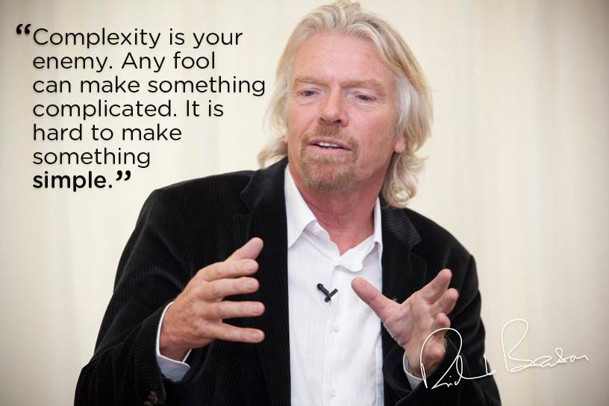
H2O’s Mission
Making Machine Learning Accessible to Everyone
Photo credit: Virgin Media

Slide 31
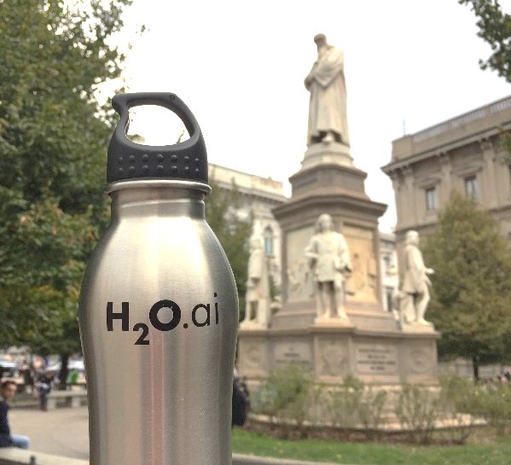
Grazie mille!
Data Science Milan
Gianmario Spacagna
Politecnico di Milano
Resources
bit.ly/h2o_milan_1
www.h2o.ai
docs.h2o.ai
Contact
joe@h2o.ai
@matlabulous
github.com/woobe

